Slide 1
Secure Data Hiding In Images Using Steganography
CAPSTONE PROJECT
Presented By: Kandati Bhanuprakash
Student Name : Kandati Bhanuprakash
College Name & Department : Malla Reddy Engineering College/CSE-CS

Slide 2
OUTLINE
Problem Statement
Technology used
Wow factor
End users
Result
Conclusion
Git-hub Link
Future scope

Slide 3
Problem Statement
With the increasing need for secure communication, traditional encryption methods alone may not be sufficient to prevent unauthorized access. Steganography provides an additional layer of security by hiding confidential data within images, making it less susceptible to detection. This project aims to develop a system that embeds secret messages into images and retrieves them using a password, ensuring data privacy and secure information exchange.

Slide 4
Technology used
Programming Language: Python
Libraries:
OpenCV – for image processing
NumPy – for numerical operations
PIL (Pillow) – for handling image files
Cryptography – for securing the message
Platform: Windows / Linux
IDE: PyCharm / VS Code / Jupyter Notebook

Slide 5
Wow factors
The project ensures highly secure communication by integrating an advanced encoding technique that modifies pixel data in a way that is nearly impossible to detect.
Unlike traditional steganography projects, this system incorporates a dynamic message embedding technique that adapts based on image properties, maximizing security.
The encryption process allows for customizable security levels, enabling users to choose between different encoding strengths based on sensitivity.
The implementation is lightweight and can be executed on low-end systems without compromising performance, making it accessible to a wide range of users.

Slide 6
End users
Cybersecurity Professionals
Government Agencies
Financial Institutions
Confidential Data Handlers
Secure Communication Platforms
Military

Slide 7
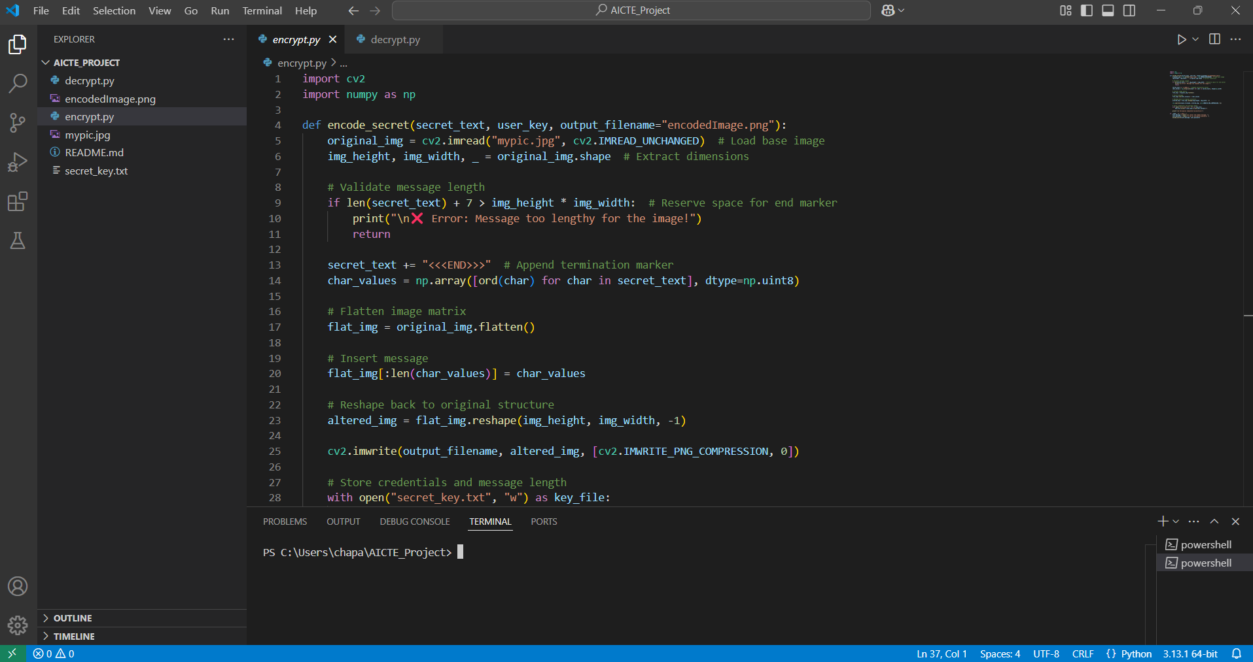
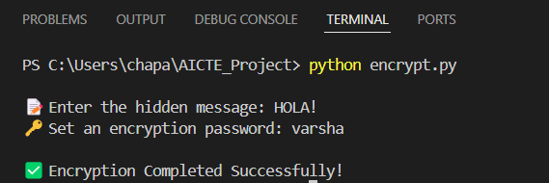

Results

Slide 8
Conclusion
This project successfully demonstrates a secure method for embedding and extracting hidden messages within images, ensuring confidentiality in digital communication.
By combining steganography with encryption, it enhances data security, making it difficult for unauthorized users to detect or access hidden information.
The system maintains image quality while efficiently concealing messages, making it a practical solution for covert communication.
With its lightweight and optimized implementation, this project provides a reliable and accessible approach to secure data transmission for various industries.

Slide 9
GitHub Link
https://github.com/kandati-bhanu/Secure-Data-Hiding-Using-Steganography

Slide 10
Implementing advanced cryptographic techniques to further enhance data security and prevent brute-force attacks.
Extending the concept beyond images to hide data in audio, video, and document files for broader applications.
Integrating AI-based methods to make hidden data resistant to forensic analysis and detection.
Developing a cloud-based or web-based platform for real-time secure data hiding and retrieval.
Optimizing the algorithm to support larger data embedding without affecting image quality.
Future scope(optional)

Slide 11
THANK YOU

